Slide 1
Energy Efficiency & Conservation
Steven Chu, U.S. Secretary of Energy, 2009:
"If I were emperor of the world, I would put the pedal to the floor on energy efficiency and conservation for the next decade.”
Notes:
Steven Chu is the US Secre (click) … and in 2009, he said.. (read it right off the slide)
Let’s talk about some more energy technology of the future—but this time it’s technology that addresses the demand side of the equation (or something) (click)

Slide 2
Idaho Peak Energy Use, 2011-2020
Total Savings, 2010-2020, through capturing efficiency:
$1,250,000
Growth rate 1%, in megawatt hours demanded
3,800
$23,450
$23,450
3,750
$23,450
3,700
$23,450
$23,450
3,650
$23,450
3,600
$23,450
3,550
$23,450
$23,450
3,500
$23,450
3,450
3,450
3,455
3,460
3,465
3,470
3,476
3,481
3,486
3,491
3,497
3,480
3,514
3,550
3,585
3,621
3,657
3,694
3,730
3,767
3,805
3,480
3,514
3,550
3,585
3,621
3,657
3,694
3,730
3,767
3,805
2011
2012
2013
2014
2015
2016
2017
2018
2019
2020
Demand Forecast
Capturing Efficiency/2020
Notes:
In 2009 the Northwest Power Planning Council estimated we could save 85% of our demand growth by prioritizing energy efficiency and energy conservation.
We did it!

Slide 3
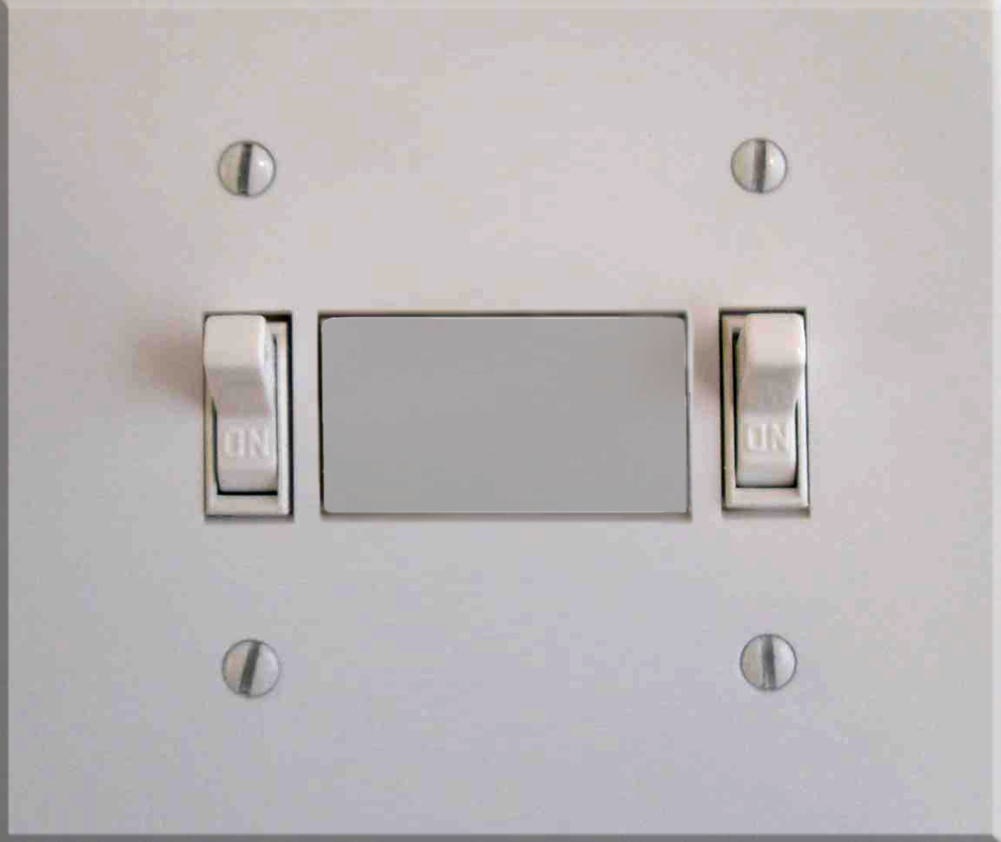
Energy Conservation in 2020
Big Ideas that changed our culture
RANK TODAY
1st
THIS BILL
3rd
TODAY
$3.20
THIS BILL
$27.11
$.35/h
.4 kw
6% hh
$.42/h
.5 kw
7% hh
Monitoring habits at the switch

Slide 4
Energy Conservation in 2020
Transparency from Smart Technology
Monitoring habits from the
“Energy Dashboard.”
The Energy Dashboard goes in the kitchen—the brain of household energy waste.

Slide 5
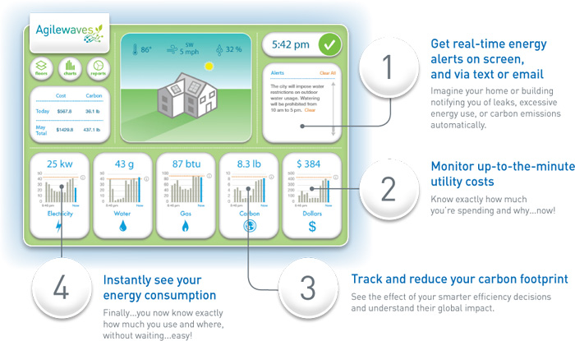
Energy Conservation in 2020
Energy Dashboard
Interface Detail

Slide 6
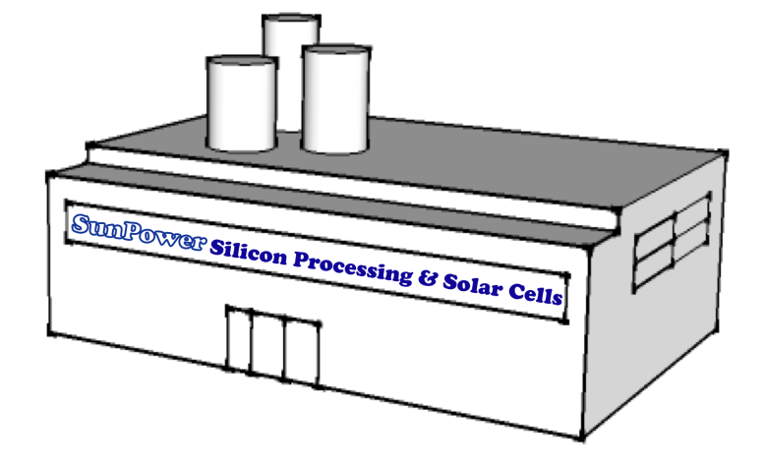
In 2020, Distributed Energy
is part of all our lives
Existing Wholesale
Energy Market
Idaho Power Company
Notes:
The smart grid might look a lot like our existing grid. We’ve got the wholesale energy market (click)
and the utility (click).
And the utility buys electricity from the wholesale market and feed it into the grid. And we have households (click) and households demand this power from the grid, which is managed by the utility (click)
But in 2020, 30,000 households have instaledl some self generation systems, like solar, micro-wind, micro-hydro (click).
And when they over-generate, they sell that power to the grid, just like the wholesale market does (click).
Ultimately this is how the utility are reducing purchases from the whoesale market (click),

Slide 7
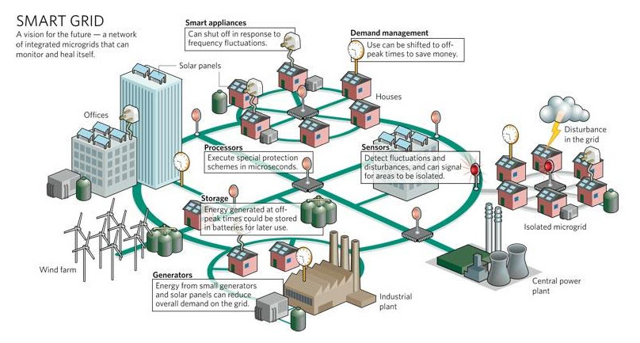

Slide 8
In 2020, Idaho schools are smart about energy education
1200 Schools across the State
400,000 Students + 35,000 faculty-support
Notes:
In 2020 Idaho has 1200 public school facilities and all have been upgraded to become

Slide 9
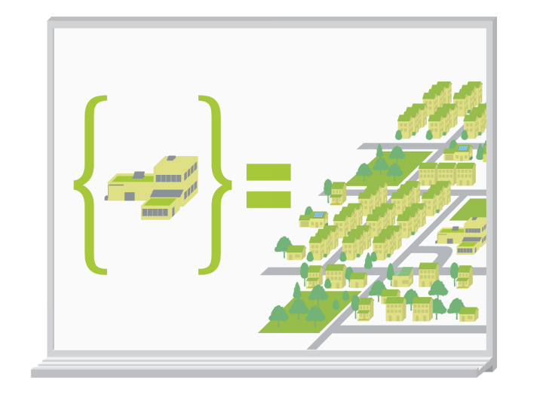
Green Schools = Green Communities
Energy education is continuous and begins early
Conserve and produce energy, limit waste, and eliminate toxicity
Research and innovation drives progress and creates a talented work force for the clean energy economy
Children inspire and lead their communities
Notes:
Green schools = green communities. Building green schools had a ripple effect encouraging more green buildings and increased awareness of the intangible benefits of energy efficiency/conservation, energy production and clean inspired green buildings.

Slide 10
Energy Mix in 2030?
Traditional Hydro
25%
Micro Hydro
15%
Wind
15%
Geothermal
20%
Solar
20%
Biomass
5%
Notes:
Through the determined leadership of our State Legislature and the bold Renewable Energy Portfolio they put in place in 2012 we have achieved 100% Clean Renewable Energy in Idaho in 2030

Slide 11
Policy changes happen when we give courage to our elected representatives.
Cultural changes happen when leaders inspire imagination.
Idaho Energy Collaborative

